Slide 1
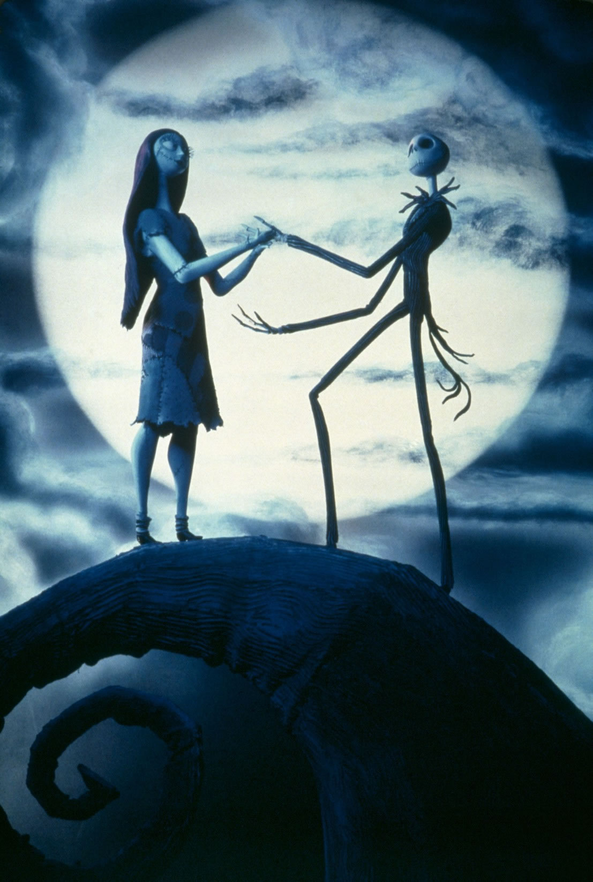
Stop Motion Animation Across the Curriculum
Carri Marostica
Karen Young
Mike Fell
Serrano High School’s Partnership Academy
Snowline Joint Unified School District

Slide 2
What Is Stop Motion Animation?
“In animation stop motion animation is a cinematic process, or technique used to makes static objects appear as if they were moving. This technique is commonly used in claymation and puppet-based animation. The objects are brought to life by breaking up the figure's motion into increments and filming one frame of film per increment.” -http://www.webopedia.com/TERM/S/stop_motion_animation.html

Slide 3
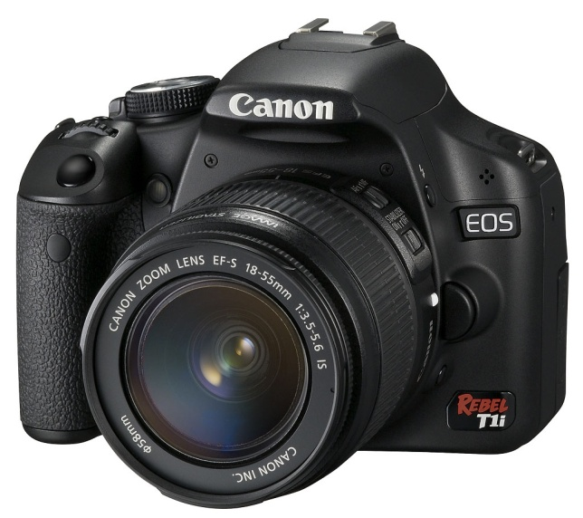
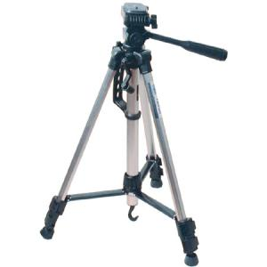
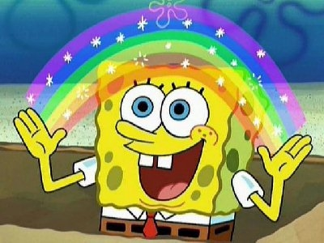
Equipment Required
Digital Camera (still or video)
Computer
Tripod or stable surface
Imagination!

Slide 4
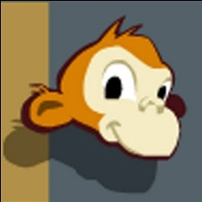
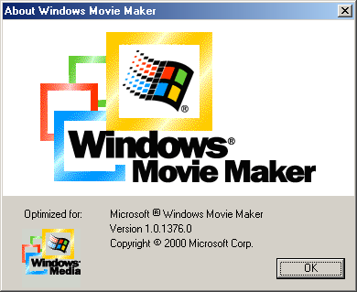
Resources
Freeware
Audacity (http://audacity.sourceforge.net/download/)
Monkey Jam (http://monkeyjam.en.softonic.com/)
Picasa (http://picasa.google.com/)
Software
Adobe Premiere
Windows Movie Maker (comes with most computers)

Slide 5
Stop Motion Animation Unit
Teach Vocabulary
Show examples of Behind the Scenes of “Nightmare Before Christmas”
Show Youtube examples
Practice moving an object from point A to point B

Slide 6
Stop Motion Animation Unit
Create a script
Draw a storyboard
Film your movie
Edit your movie with music, sound FX, and voiceover
Present your movie

Slide 7
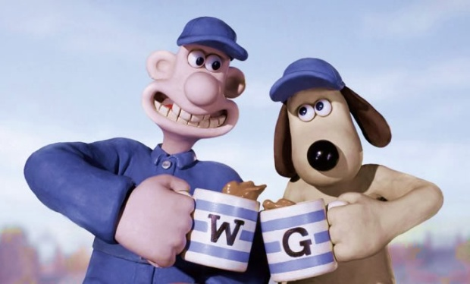
Across the Curriculum (example)
English- Write a script complete with action description and dialogue
History- Your story must be based in or surround a historical event.
Multi-media- Shoot, Edit, Present

Slide 8
Create Your Own Stop Motion Animation
Get into pairs or groups of 3
Create your characters and make them come to life
Examples of Characters
PlayDoh
Cell Phone
Keys
Upload your pictures
Edit
Show your work (museum tour)

